Slide 1
Idea Protection and Intellectual Property
Enterprise Management for Computer Scientists
Fall 2017

Slide 2
Consumer Sovereignty
“The purpose of business is to create a customer. Not products, not profit—customers. Mind the customer and the store will take care of itself.”
—Peter Drucker

Slide 3
Competition and Value Creation
Businesses create value
But can they capture it?
Competition—PESTEL, SWOT, Porter’s Five Forces
So how do competitive firms stay profitable?

Slide 4
Informal Intellectual Property
“Market-based protection”
Secrecy
Lead time
Complexity
Confidentiality
Incentives
Branding
Geographical
Contacts
Not (usually) legally enforceable

Slide 5
Formal Intellectual Property
“Non-market protection”
Legal right to defend claim against infringement
Legal details vary by country
Why “intellectual”?
Why “property”?

Slide 6
Types of Intellectual Property (IP)
There are five major types of IP
Patents—“inventions and products, e.g. machines and machine parts, tools, medicines.”
Copyrights—“literary works (including writing), art, photography, films, TV, music, web content, sound recordings.”
Trade marks—“product names, logos, and jingles.”
Design rights—“shape of objects.”
Registered designs—“appearance of a product including, shape, packaging, patterns, colours, and decoration.”
Source: UK Intellectual Property Office

Slide 7
Infringement
“Infringement” is a legal term for an act that means breaking a law. IP rights are infringed when a product, creation or invention protected by IP laws are exploited, copied or otherwise used without having the proper authorisation, permission or allowance from the person who owns those rights or their representative. (UK Intellectual Property Office)
Public and/or commercial use of IP tend to be enforced most

Slide 8
Patents
“Inventions and products, e.g. machines and machine parts, tools, medicines.”
Cannot patent
Unoriginal ideas
Plants, seeds, animals, immoral or offensive ideas
Ideas covered by other types of IP
Must be applied for
Usually take 3-4 years to be granted
Can be rejected
Last 20 years from the date of application

Slide 9
Exploiting a Patent
Sell
Or,
Retain
— Direct use
— Sharing
— License technology
— Open source

Slide 10
“In accordance with a first aspect of the present invention, there is provided a transportation facilitation device including a circular rim, a bearing in which a hollow 5 cylindrical member is rotatable about a rod situated within the hollow cylindrical member, and a series of connecting members connecting the circular rim with the hollow cylindrical member to maintain the circular rim and the hollow cylindrical member in substantially fixed relation, wherein the rod is positioned on an axis perpendicular to the plane of the circular rim, and substantially central of the circular rim.” (AU 2001100012 A4)

Slide 11
Patent Trolls
Patent ownership without a product or service
Patent assertion entity (PAE)
Non-practicing entity (NPE)
Trolls now account for 84% of patent litigation in the US
US: Each party pays its own legal fees
Europe: loser pays all legal fees

Slide 12
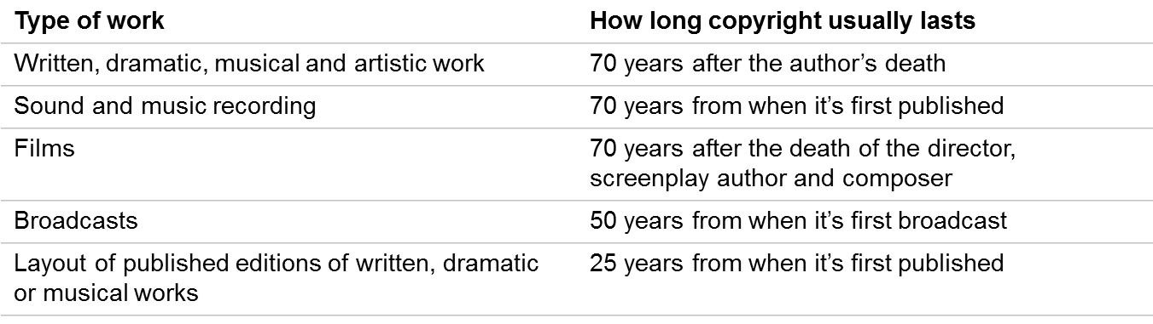
Copyright ©
“Literary works (including writing), art, photography, films, TV, music, web content, sound recordings.”
Granted automatically in the US and UK
Subject to “fair dealing” or “fair use”

Slide 13
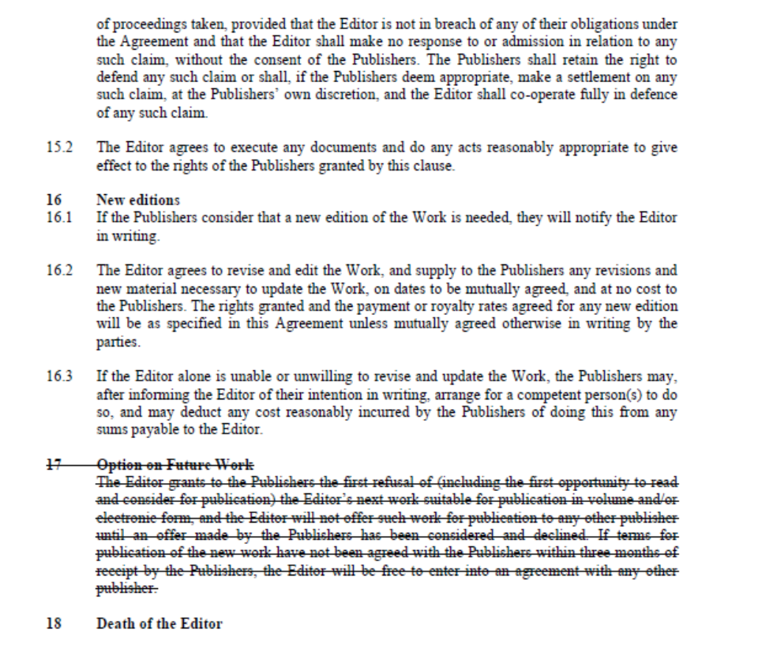

Slide 14
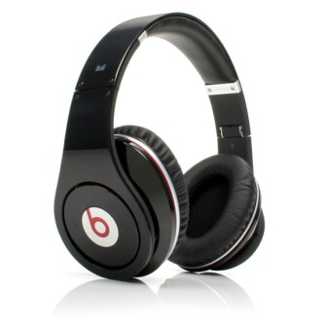
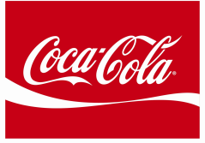

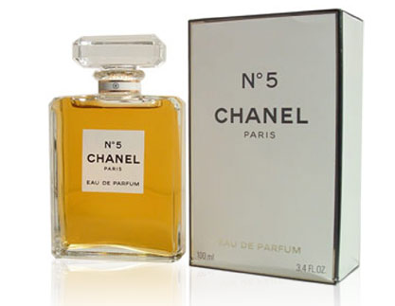
Trade Marks
“Product names, logos, and jingles” (esp. in the form of words, colours, and sounds)
Trade marks distinguish people and products
Must be distinctive
Can’t be offensive, misleading, too common, or only descriptive
Unregistered trade marks™
Established by “first to use”
Can be protected, but difficult
“Passing off”
Registered trade marks ®
Usually take about 9 months to be registered
Registration lasts ten years, after which time it must be renewed
45 different classifications in the UK

Slide 15
Design Rights (Design Patents)
“The shape of objects” and “Appearance of a product including, shape, packaging, patterns, colours, and decoration.”
Unregistered design rights are acquired automatically
3D only
Lasts 10 years after first sale or 15 after creation, whichever earlier
Registered design rights are more explicit, easier to defend
2D and 3D
Lasts 25 years

Slide 16
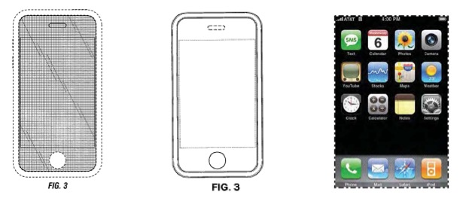

Slide 17
Innovation and IP
Pro-IP argument: IP incentivizes innovation
Product innovation is costly, sometimes prohibitively
E.g. pharmaceutical testing

Slide 18
Innovation and IP, Cont’d
Anti-IP argument: IP undermines innovation
Barrier to entry
— Legal prohibition of competition
Cost of defensive use
— “If we don’t protect it, someone else will.”
Opportunity cost
— Channel funding away from R&D, toward litigation

Slide 19

Innovation vs. Litigation
“We’re going to patent it all.”
—Steve Jobs (c. 2006)

Slide 20
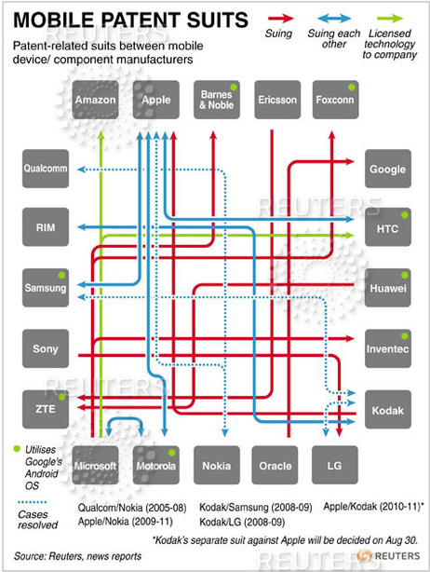
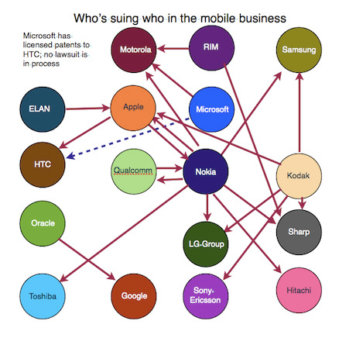
The Great Phone War

Slide 21
For Next Time…
IP Case Study: Spotify
What types of IP does Spotify use?
Does it produce and own any IP? Does it license any?
— Provide examples
— Search (inter)national IP databases
What opportunities or threats does Spotify face?
How could IP laws be reformed to make the music industry more competitive and innovative?
Hint: think of the various legal traits of copyrights and how they could be changed

